Slide 1
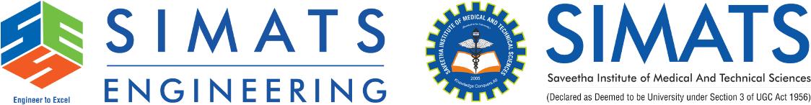
Intelligent Multi-Cloud Security Posture Management System
ITA1406-Ethical Hacking
Guided By
Dr A Ezhil Grace
Presented By
Atchaya Chandran R-192521394
Hariharan B-192511394
Mukesh V-192524359

Slide 2
Introduction
Intelligent Multi-Cloud Security Posture Management System (MCSPM) monitors and manages the security of multiple cloud platforms from a single dashboard.
It uses Artificial Intelligence (AI) to detect security risks, misconfigurations, and compliance issues in real time.
The system provides centralized visibility, automated alerts, and quick remediation to improve cloud security.
It helps organizations reduce cyber threats, maintain compliance, and ensure secure and efficient cloud operations.
The system improves overall cloud security by providing intelligent threat detection, automated risk assessment, and continuous compliance monitoring.

Slide 3
Problem Statement
Lack of Centralized Visibility: Managing security across multiple cloud platforms is difficult due to the absence of a unified monitoring system.
Security Misconfigurations: Incorrect cloud configurations can expose sensitive data and increase the risk of cyberattacks.
Compliance Challenges: Ensuring compliance with security standards and regulations across different cloud providers is complex.
Delayed Threat Detection: Traditional security tools often fail to detect vulnerabilities and security threats in real time.
Manual Security Management: Manual monitoring and remediation are time-consuming, error-prone, and inefficient in large multi-cloud environments.

Slide 4
Objectives
To discover and maintain an inventory of cloud assets across multiple cloud platforms, ensuring complete visibility of cloud resources.
To identify security vulnerabilities, misconfigurations, and assess the overall security posture of cloud environments.
To detect cyber threats using intelligent analytics and AI-based techniques for early threat identification.
To analyze, prioritize, and evaluate security risks based on their severity, likelihood, and potential business impact.
To automate security incident response and remediation processes, reducing response time and minimizing security risks.
To continuously monitor compliance with organizational policies and industry security standards while generating real-time alerts and reports.

Slide 5
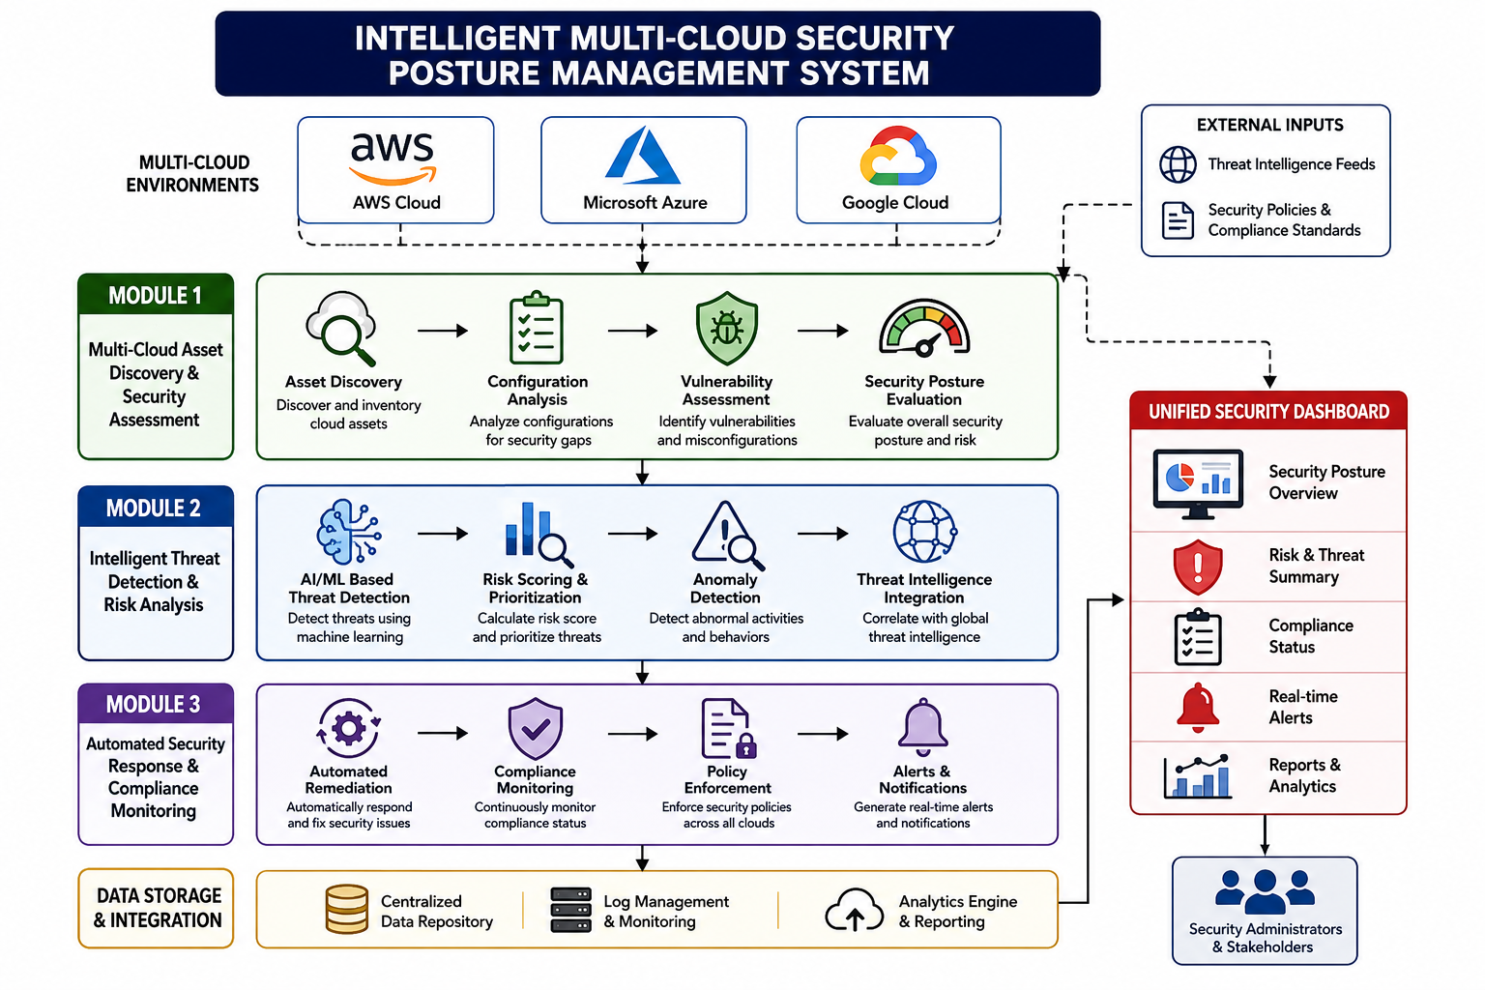
Block Diagram

Slide 6
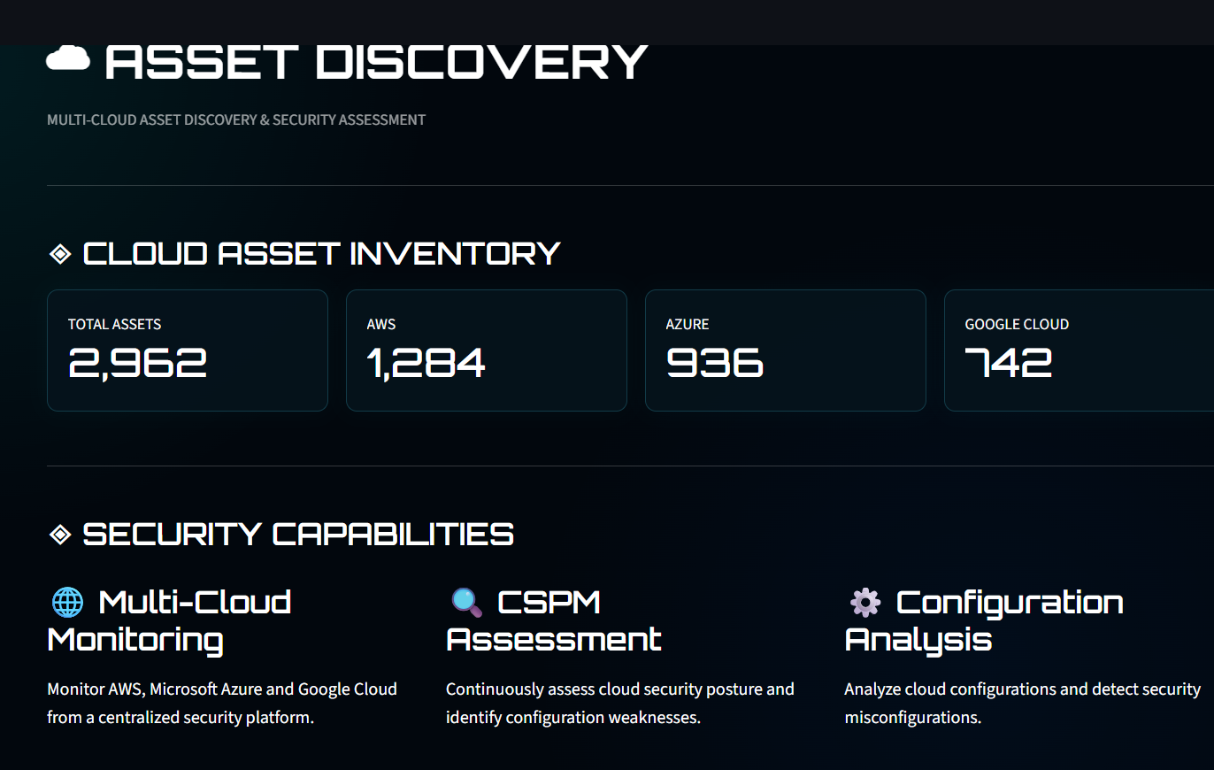
Module 1 – Multi-Cloud Asset Discovery & Security Assessment
Multi-Cloud Asset Discovery – Automatically discovers and inventories resources across AWS, Azure, and Google Cloud.
Cloud Configuration Assessment – Analyses cloud configurations to identify security misconfigurations and policy violations.
Vulnerability Identification – Detects vulnerabilities and security weaknesses that may expose cloud resources to cyber threats.
Security Posture Evaluation – Assesses the overall security posture of cloud environments and prioritizes risks.
Centralized Asset Visibility – Provides a unified view of all cloud assets, enabling efficient monitoring and security management.

Slide 7
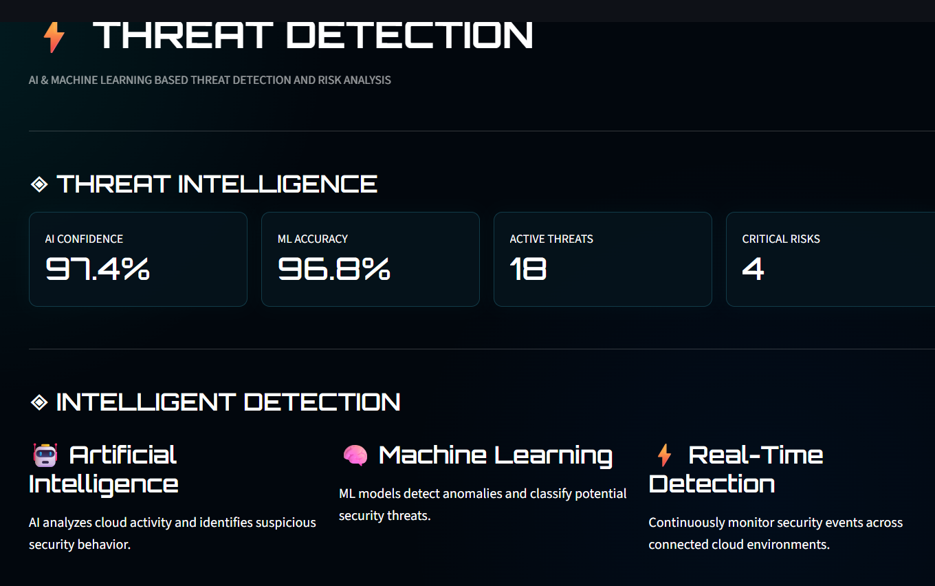
Module 2 – Intelligent Threat Detection & Risk Analysis
AI-Based Threat Detection – Uses Artificial Intelligence and Machine Learning to identify cyber threats and suspicious activities.
Anomaly Detection – Detects unusual user behaviour, network traffic, and cloud activities that may indicate security attacks.
Risk Assessment – Analyses identified threats, evaluates their severity, and assigns risk scores for prioritization.
Threat Intelligence Analysis – Correlates threat data with known attack patterns to improve detection accuracy.
Real-Time Security Alerts – Generates instant alerts and recommendations to enable quick response to potential security incidents.

Slide 8
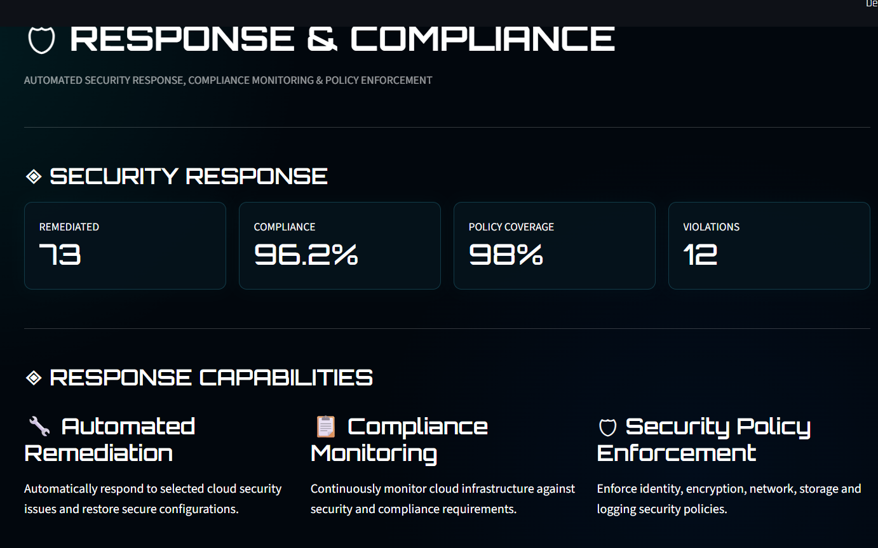
Module 3 – Automated Security Response & Compliance Monitoring
Automated Security Response – Automatically responds to detected threats by initiating predefined security actions.
Compliance Monitoring – Continuously monitors cloud environments to ensure compliance with security standards and regulations.
Security Policy Enforcement – Enforces organizational security policies consistently across all multi-cloud platforms.
Automated Remediation – Corrects security misconfigurations and vulnerabilities automatically to reduce risks.
Real-Time Reporting & Alerts – Generates instant security alerts, compliance reports, and audit logs for effective monitoring and decision-making.

Slide 9
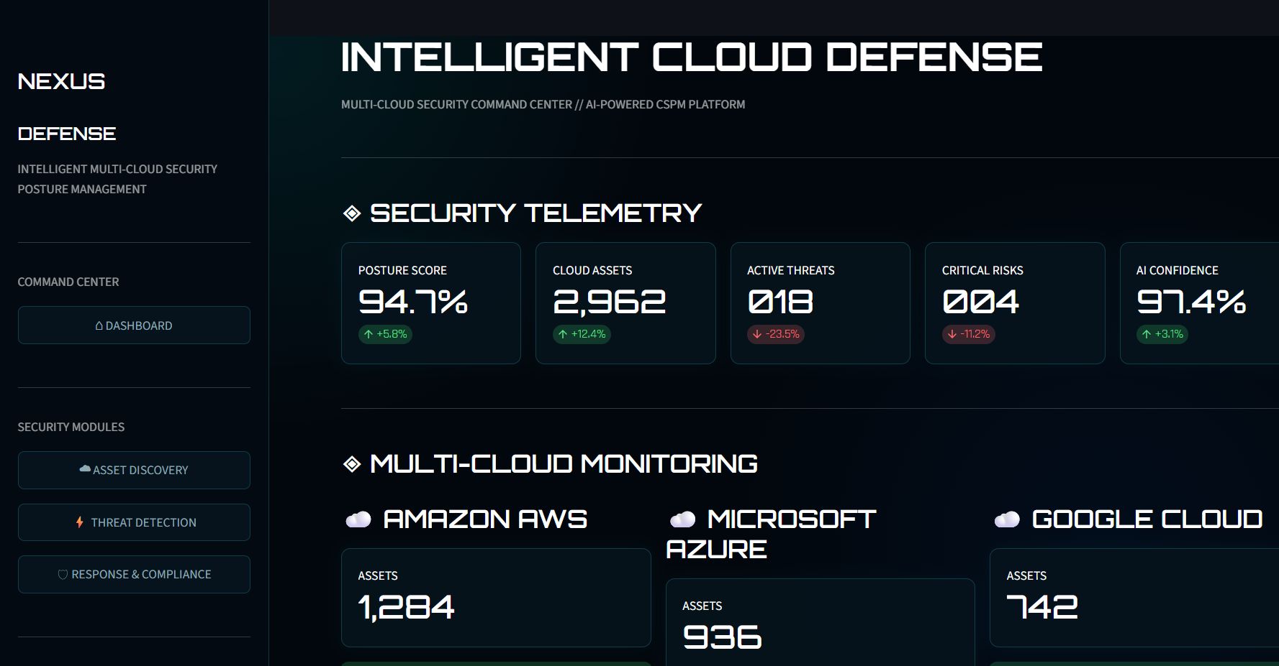
User Interface Design

Slide 10
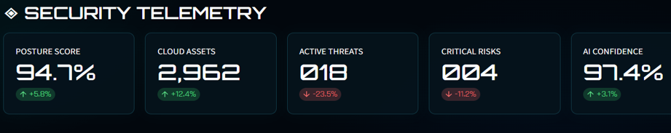
Result
Achieved a 94.7% security posture score, indicating a highly secure and well-managed multi-cloud environment.
Discovered and monitored 2,962 cloud assets, ensuring comprehensive visibility and effective asset management.
Reduced active threats to 18 and critical risks to 4, demonstrating efficient threat detection and risk mitigation.
Achieved 97.4% AI confidence in threat detection, enabling accurate analysis and supporting automated security monitoring and response.
Enabled continuous compliance monitoring, ensuring cloud resources adhere to security policies and regulatory standards through real-time monitoring and automated reporting.

Slide 11
Conclusion
The proposed system provides a centralized and intelligent approach to securing multiple cloud environments.
It effectively detects security threats, identifies vulnerabilities, and performs real-time risk assessment using AI-based techniques.
Automated security response and compliance monitoring improve operational efficiency while reducing manual intervention.
The system enhances cloud security, ensures regulatory compliance, and supports reliable multi-cloud management.
Overall, the Intelligent Multi-Cloud Security Posture Management System offers a scalable, secure, and efficient solution for protecting modern cloud infrastructures.

Slide 12
Future Scope
Integration with More Cloud Platforms – Extend support to additional public, private, and hybrid cloud environments for comprehensive security management.
Advanced AI-Based Threat Prediction – Incorporate predictive AI models to identify and prevent cyber threats before they occur.
Zero Trust Security Implementation – Integrate Zero Trust Architecture to provide stronger identity verification and access control.
Enhanced Compliance Automation – Support multiple international compliance standards with automated auditing and reporting.
Self-Healing Cloud Security – Develop intelligent automated remediation mechanisms that can detect, analyse, and resolve security issues with minimal human intervention.

Slide 13
References
National Institute of Standards and Technology (NIST), Security and Privacy Controls for Information Systems and Organizations (SP 800-53 Rev. 5), NIST, 2020.
Cloud Security Alliance (CSA), Security Guidance for Critical Areas of Focus in Cloud Computing v5.0, Cloud Security Alliance, 2024.
International Organization for Standardization (ISO), ISO/IEC 27001:2022 – Information Security, Cybersecurity and Privacy Protection, ISO, 2022.
Amazon Web Services, AWS Well-Architected Framework – Security Pillar, Amazon Web Services, 2024.
Microsoft Corporation, Microsoft Azure Security Documentation, Microsoft, 2024.
Google Cloud, Google Cloud Security Best Practices, Google LLC, 2024.
National Institute of Standards and Technology (NIST), Cybersecurity Framework (CSF) 2.0, NIST, 2024.
IEEE Xplore Digital Library, Research Articles on Multi-Cloud Security, Cloud Security Posture Management (CSPM), and AI-Based Threat Detection, https://ieeexplore.ieee.org/
Microsoft Learn, Microsoft Defender for Cloud Documentation, https://learn.microsoft.com/azure/defender-for-cloud/
Palo Alto Networks, Prisma Cloud Documentation – Cloud Security Posture Management (CSPM), https://docs.paloaltonetworks.com/prisma-cloud

Slide 14


